Slide 1
User Guide
Incident Report

Slide 2
Incident Report
The List of pages for Incident Report Module is listed below:
Incident Types
Register Incident
Incidents Report
Action on Incident
Incident Dashboard
Login to GOP application with the URL provided by application administrator. Select Incident Report Menu option from top menu Panel. This menu panel will be visible / accessible, if application administrator has granted you the rights

Slide 3
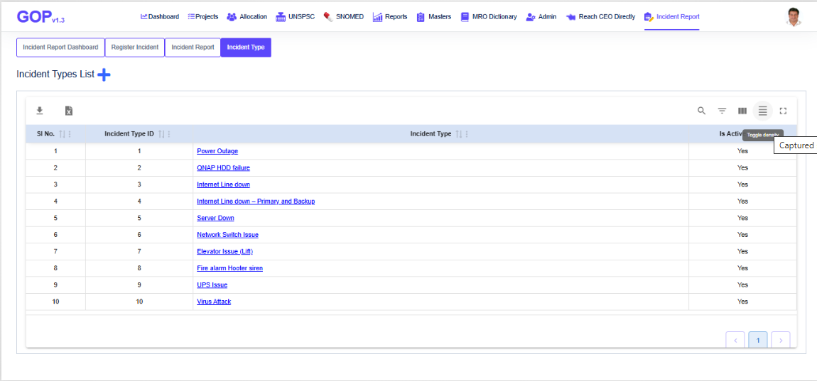
Incident Types

Slide 4
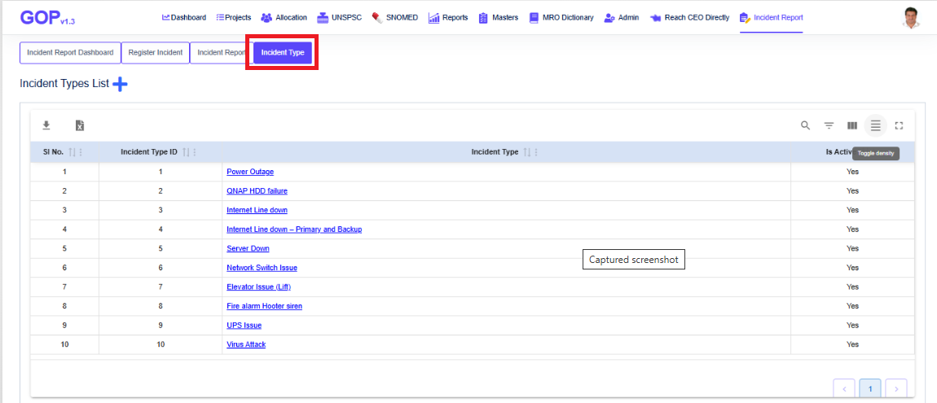
1 Incident Types
1.1 Add New Incident Type
To add a new Incident Type , follow the below steps,
Click on “Incident Types” tab from the set of tabs

Slide 5
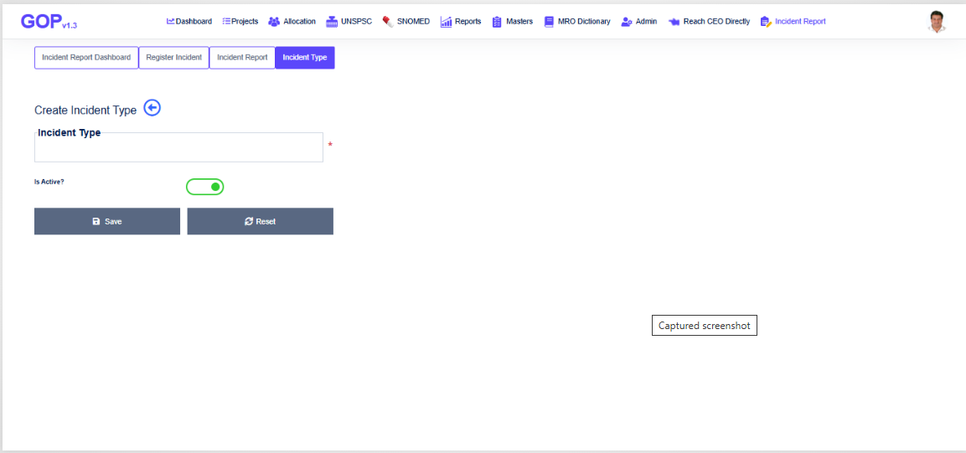
Application shows all the incident types list added till date.
Click on “+” sign to add new “Incident Type” beside the Incident Types List heading of page
Application shows the new page as below to create new incident type
Enter new Incident Type e.g. Virus Attack
Click on Save button to create a new incident type

Slide 6
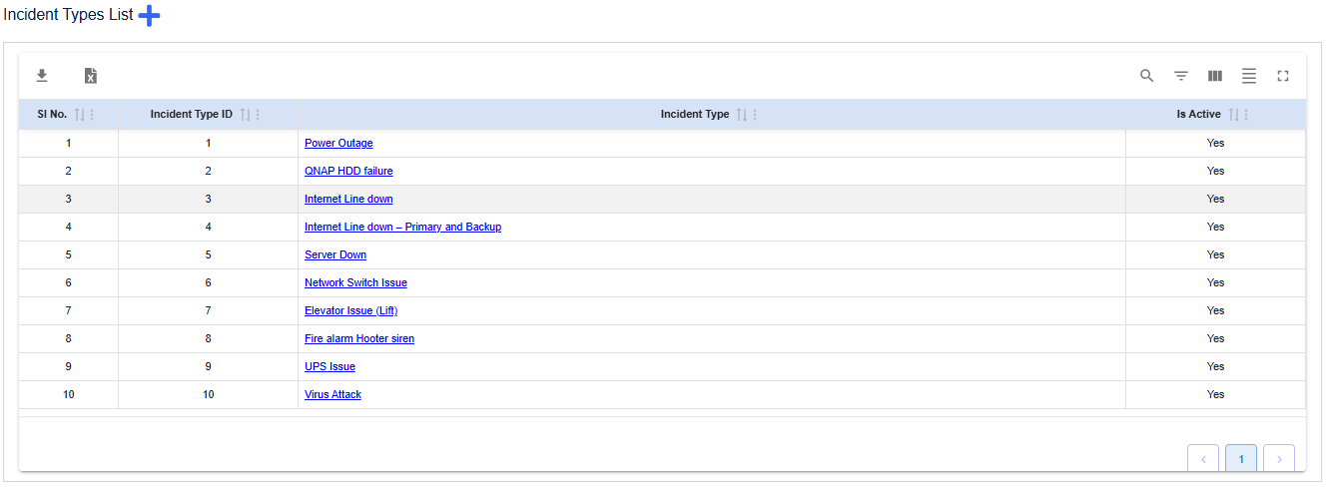
1.2 Incident Types List
To view the list of Incident Types, click on Incident Type tab from the set of tabs
Application shows the list of all available list of incident types

Slide 7
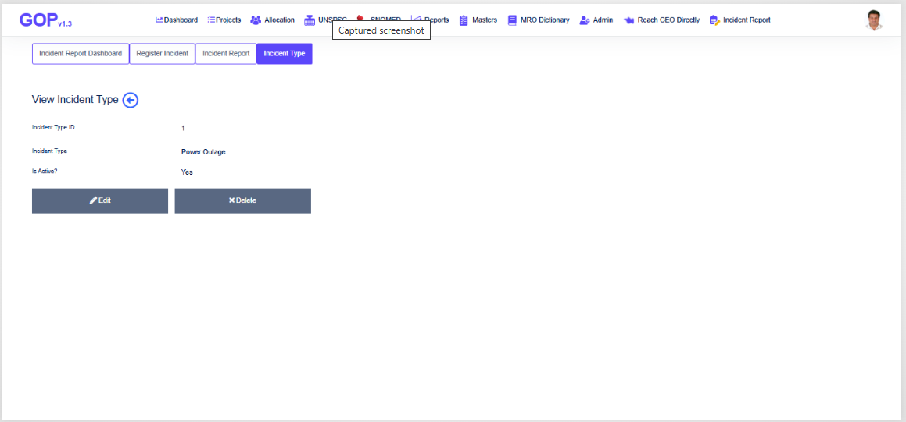
1.3 View Incident Type
To view any incident type, click on Hyperlink of that Incident Type from Incident Types List page
Application shows the Incident Type details as in below screenshot

Slide 8
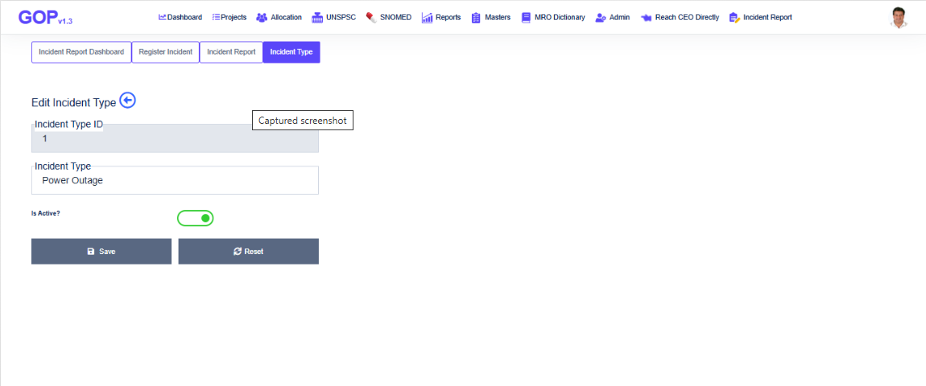
1.4 Edit Incident Type
To edit any incident type, click on Edit button from View Incident Type page
Application shows the Incident Type details as in below screenshot
Edit Incident Type text as required and click on “Save” button
Application saves the changes and redirects the page to Incident Types List

Slide 9
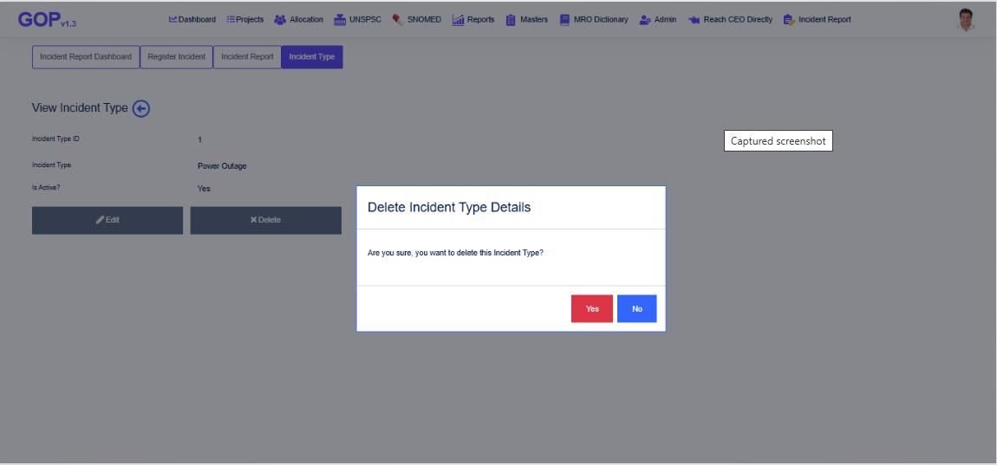
1.5 Delete Incident Type
To delete incident type, click on delete button from View Incident Type page
Application confirms the delete operation as in below screenshot
Click on Yes button to delete the Incident Type
Click on No button to cancel the delete operation

Slide 10
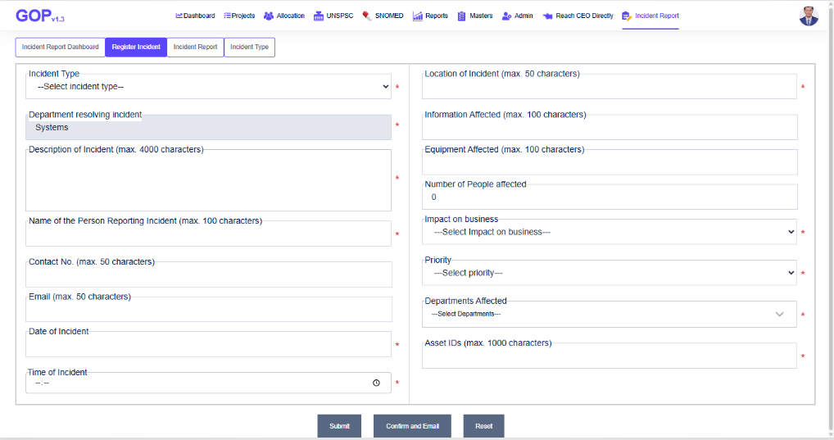
2. Register Incident
To register an incident, click on “Register Incident” tab from the set of tabs
Application shows the Register Incident page as in below screenshot
Enter all the details of Incident as in above screenshot
Click on Submit to register / save the incident. You can edit it as many times as you want until all the changes confirmed.
We can click on “Confirm and Email” button, if we are sure about the incident details entered
On clicking Submit / Confirm, application generates incident no.
On confirm, application sends an email to concern employees about the details of incident

Slide 11
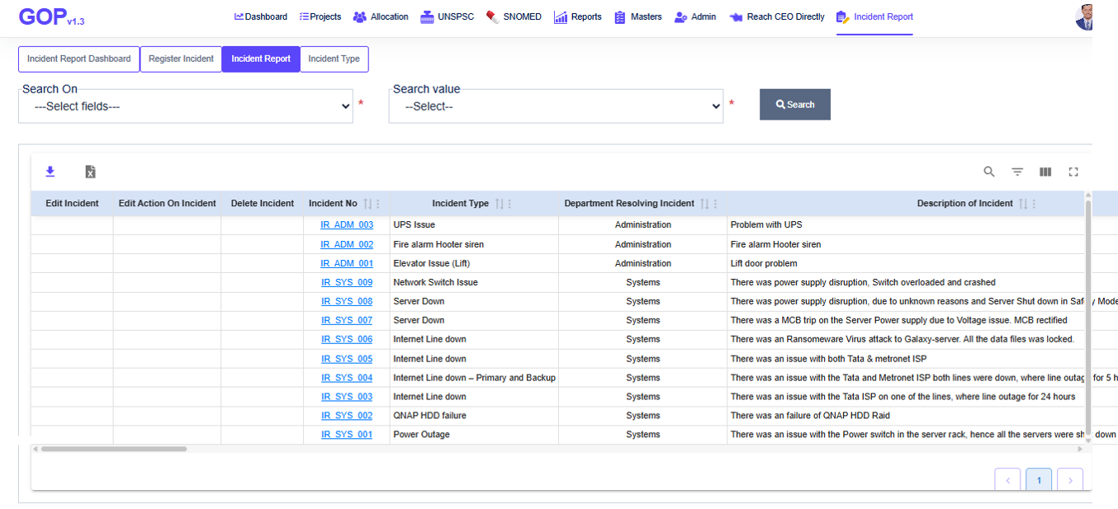
2.1 Incident Report
To view the list of all incidents, click on “Incident Report” tab from the set of tabs
The list of all incidents can be exported to excel / csv formats by using the buttons above the list
Search on any field for any value from the incident

Slide 12
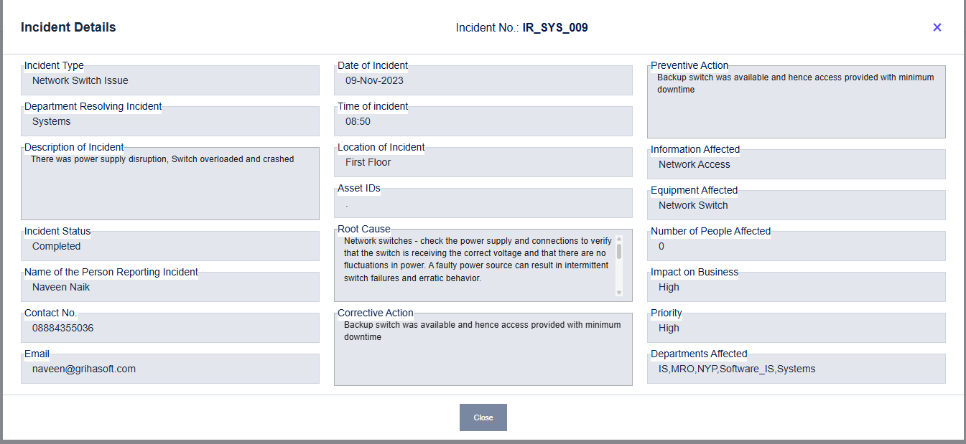
2.2 View Incident Details
To view the details of any incident, click on “Incident No.” hyperlink from the list of incidents from Incident Report page
Application shows the incident details as in below screenshot

Slide 13
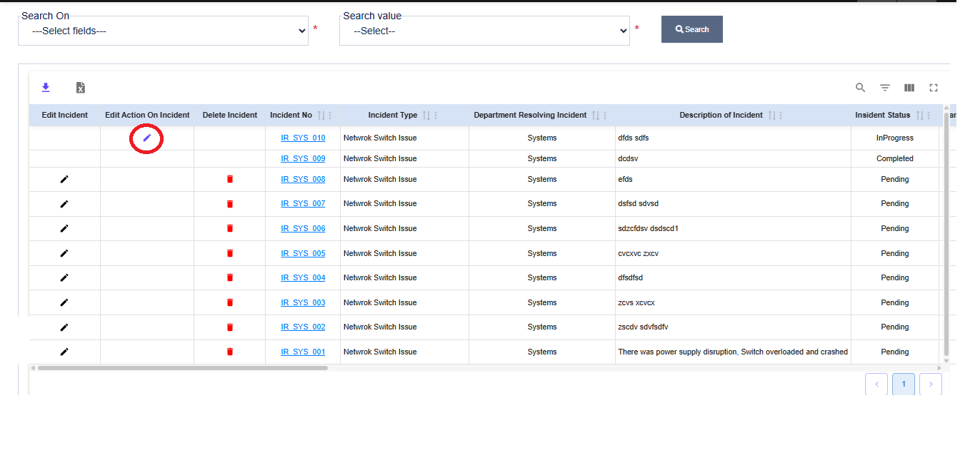
2.3 Action on Incident
To enter the action taken details on incident, click on “Edit Action on Incident” option button from “Incident Report” page as in below screenshot

Slide 14
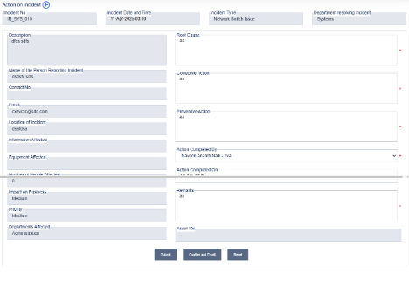
2.4 Edit Action on Incident
Enter the action details as Root Cause, Corrective Action, Preventive Action, Action Completed By and, Action Completed on
Click on Submit / Confirm button to save the action details
If you click on Confirm button, application sends an email to concerned employees about the action and you won’t be able to make any changes there after

Slide 15
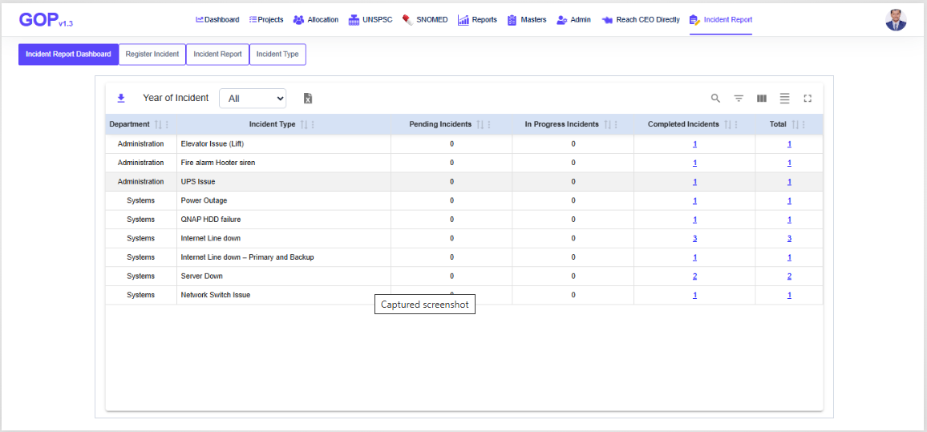
3. Incident Dashboard
Application shows the summary of incidents count based on the status of each incident.
We can see the list of incidents from any year by selecting it from the dropdown

